Slide 1
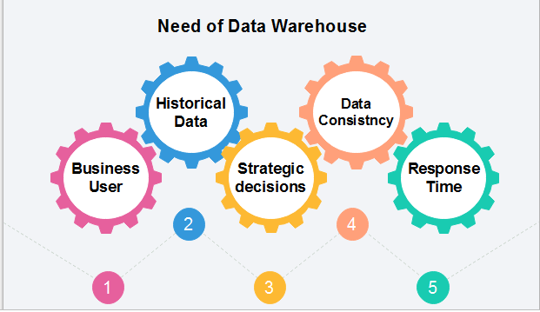
Need for Data Warehouse

Slide 2
1) Business User: Business users require a data warehouse to view summarized data from the past. Since these people are non-technical, the data may be presented to them in an elementary form.
2) Store historical data: Data Warehouse is required to store the time variable data from the past. This input is made to be used for various purposes.
3) Make strategic decisions: Some strategies may be depending upon the data in the data warehouse. So, data warehouse contributes to making strategic decisions.
4) For data consistency and quality: Bringing the data from different sources at a commonplace, the user can effectively undertake to bring the uniformity and consistency in data.
5) High response time: Data warehouse has to be ready for somewhat unexpected loads and types of queries, which demands a significant degree of flexibility and quick response time.

Slide 3
Benefits of Data Warehouse
Understand business trends and make better forecasting decisions.
Data Warehouses are designed to perform well enormous amounts of data.
The structure of data warehouses is more accessible for end-users to navigate, understand, and query.
Queries that would be complex in many normalized databases could be easier to build and maintain in data warehouses.
Data warehousing is an efficient method to manage demand for lots of information from lots of users.
Data warehousing provide the capabilities to analyze a large amount of historical data.

Slide 4
Data Warehouse Modeling
Data warehouse modeling is the process of designing the schemas of the detailed and summarized information of the data warehouse.
The goal of data warehouse modeling is to develop a schema describing the reality, or at least a part of the fact, which the data warehouse is needed to support.

Slide 5
Data warehouse modeling is an essential stage of building a data warehouse for two main reasons.
Firstly, through the schema, data warehouse clients can visualize the relationships among the warehouse data, to use them with greater ease.
Secondly, a well-designed schema allows an effective data warehouse structure to emerge, to help decrease the cost of implementing the warehouse and improve the efficiency of using it.

Slide 6
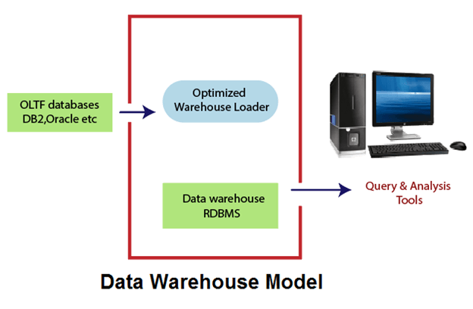

Slide 7
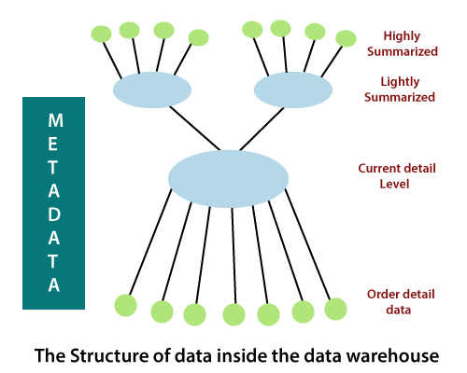

Slide 8
The current detail record is central in importance as it:
Reflects the most current happenings, which are commonly the most stimulating.
It is numerous as it is saved at the lowest method of the Granularity.
It is always (almost) saved on disk storage, which is fast to access but expensive and difficult to manage.

Slide 9
Older detail data is stored in some form of mass storage, and it is infrequently accessed and kept at a level detail consistent with current detailed data.
Lightly summarized data is data extract from the low level of detail found at the current, detailed level and usually is stored on disk storage. When building the data warehouse have to remember what unit of time is summarization done over and also the components or what attributes the summarized data will contain.
Highly summarized data is compact and directly available and can even be found outside the warehouse.
Metadata is the final element of the data warehouses and is really of various dimensions in which it is not the same as file drawn from the operational data, but it is used as:-
A directory to help the DSS investigator locate the items of the data warehouse.
A guide to the mapping of record as the data is changed from the operational data to the data warehouse environment.
A guide to the method used for summarization between the current, accurate data and the lightly summarized information and the highly summarized data, etc.

